Slide 1

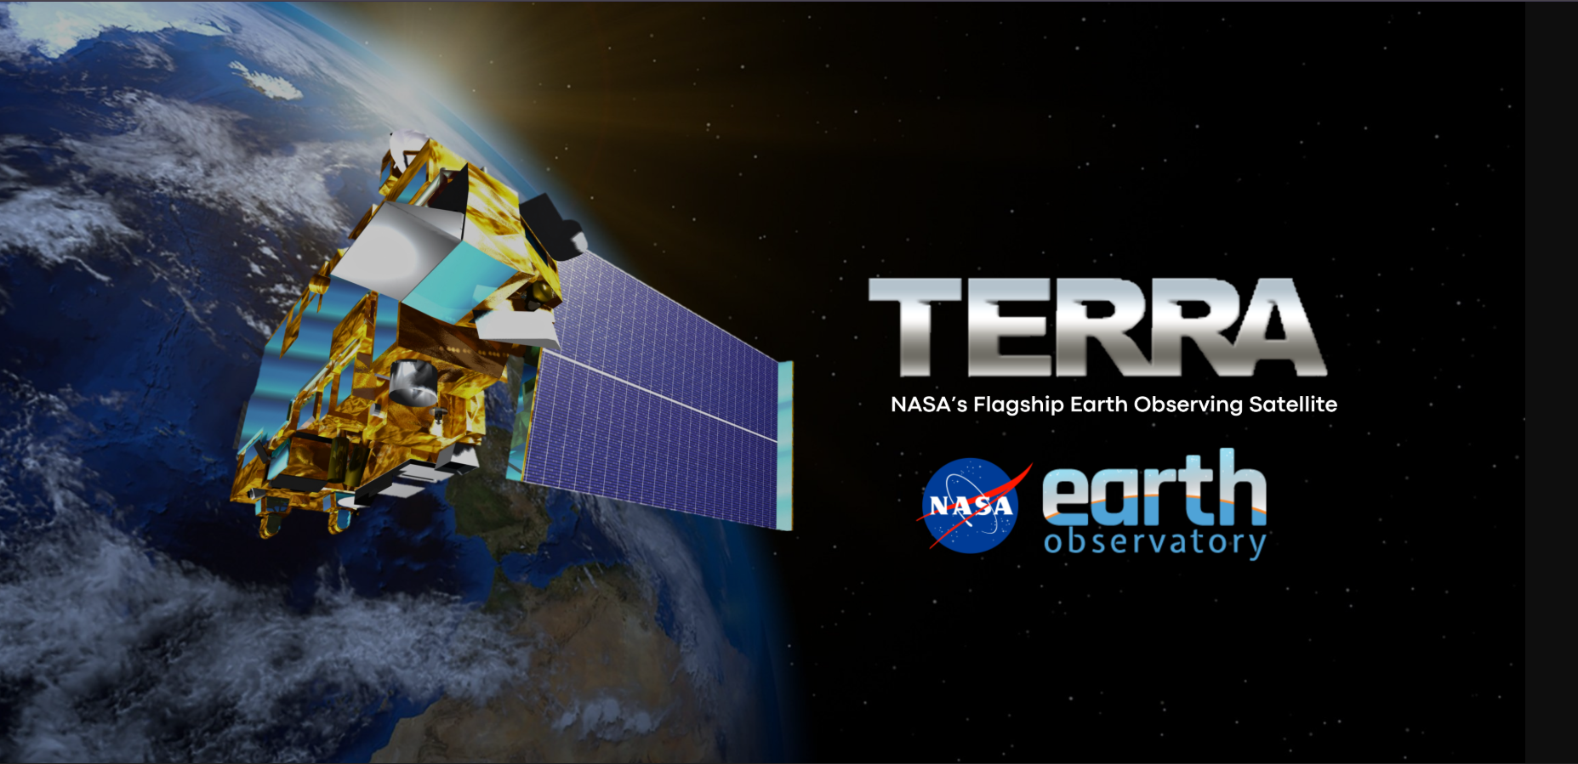
The Scarred Earth
10.05.25
Terra’s 25-Year View of Ghana’s Galamsey Crisis
SUPERNOVA 314

Slide 2
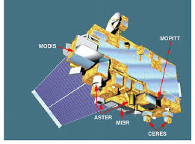
Animation Celebration of Terra Data
The challenge is to use data from Terra’s 25-year database to throw more light on how that data has impacted our community; in our case, Ghana.
The challenge involves the use of animations to tell a story based on NASA’s data from Terra’s Instrument.
Our project uses NASA’s Terra satellite data to tell a story about how illegal mining has caused vegetation loss in Ghana over the past two decades.

Slide 3
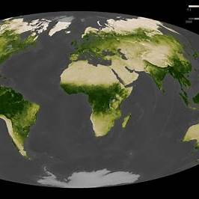
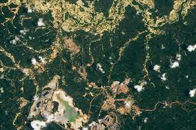
Collection of Data from Terra
Before – 2000-2002
AFTER – October, 2025

Slide 4




Analyzing Data From Terra
In our project work, data from NASA’s Earth Observatory was utilized to investigate the environmental impact of galamsey (illegal mining) activities in Ghana.
Using sets of imagery from the Terra satellite’s ASTER and MODIS instruments, we examined changes in land surface temperature, vegetation cover, and hotspot distribution.
The high-resolution ASTER images provided detailed insights into localized land degradation, while MODIS data enabled broader temporal and spatial analysis of affected regions.
This combination of datasets allowed for a comprehensive understanding of how galamsey activities alter ecosystems, supporting efforts toward environmental monitoring and sustainable resource management.

Slide 5
Data Visualization
In our project, visualization helps to highlight patterns, trends, and spatial distributions of galamsey hotspots that may not be easily noticed in raw data. By using maps and graphical models generated from ASTER and MODIS data, we can now effectively communicate the extent and environmental impact of illegal mining activities.
link to our Visualization video:

Slide 6




FINDINGS & CONCLUSIONS
Our analysis revealed the visible environmental “scars” left by galamsey activities across Ghana’s ecosystems.
Through data visualization and geospatial analysis, we demonstrated how satellite data can serve as a powerful tool for monitoring and responding to environmental damage.
Using data from the Terra satellite’s ASTER and MODIS instruments, we identified significant areas of vegetation loss, increased land surface temperature, and disrupted water bodies in mining zones.
Ultimately, our findings aim to promote data-driven conservation and restoration efforts, encouraging sustainable practices and informed policy decisions to protect Ghana’s natural resources.
These patterns highlight the severe ecological degradation caused by illegal mining.

Slide 7
